Slide 1
MASSIVE Introduction
tLab Tutorial
Haohua Li
July 2020

Slide 2
Overview
Reminder
What is MASSIVE
How to access MASSIVE
Request a M3 account
Connect via SSH
How to submit a job
Check the status of M3 cluster
Write your own job script
Submit the job script
Monitor the progress of the job
Check the returned results
Further reading

Slide 3
Reminder
This slide only covers the serial computing of MASSIVE
You could submit multiple jobs at a time to achieve manual “parallel”
Due to content limit, the parallel computing of MASSIVE will be NOT covered.
Search MATLAB, Python Parallel Computing to learn more.
MPI https://docs.massive.org.au/M3/slurm/mpi-jobs.html
Multi-threading https://docs.massive.org.au/M3/slurm/multi-threaded-jobs.html
It is NOT comprehensive and exhaustive.
If you have questions, please read the official document released by MASSIVE. https://docs.massive.org.au/index.html

Slide 4
What is MASSIVE
MASSIVE is a high-performance computing (HPC) platform that is designed for complex data analyses, computation, simulation and modelling.
A MASSIVE cluster consists of many nodes (computers) with powerful hardware, like CPU, GPU and storage devices.
It can be used across many disciplines such as numerical computation, engineering, artificial intelligence, biomedical science, geosciences and, of course, neuroscience.

Slide 5

How to access MASSIVE
Read Requesting an account
Step 1 : Log in to the HPC ID system with the Monash account (okta)
Step 2 : Create an M3 account
The M3 account can be different from the Monash credentials/account
Step 3 : Join the tLab project
ask the supervisors about the Project ID

Slide 6
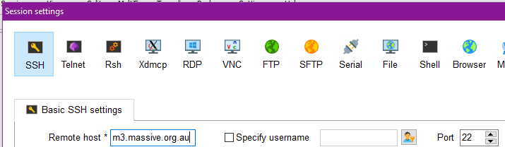
How to access MASSIVE
Read Connecting to M3 via ssh
To connect MASSIVE, a SSH client is required.
Windows user
MobaXterm/PuTTY
Start a SSH session and login with the M3 account (instead of Monash account).
MacOS/Linux
Open terminal and use the ssh command.
login with the M3 account (instead of Monash account).
Start a new session to the following address
m3.massive.org.au

Slide 7
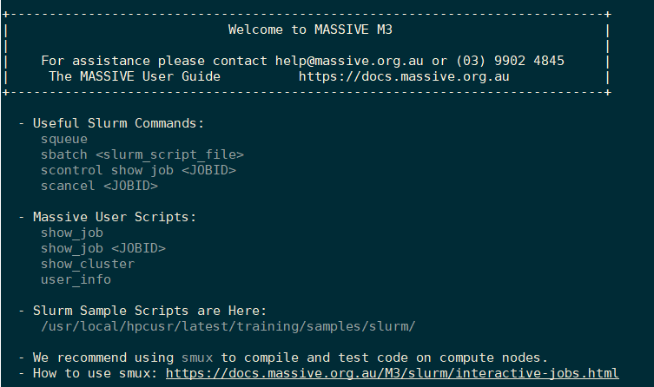
How to access MASSIVE
If the connection is successful

Slide 8
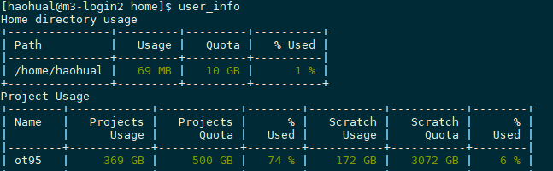
Basics - workspace (1)
Workspace and Storage
user_info to check the storage of your account.
Home directory is your personal space
with daylily backup and limited storage < 10 GB
Project directory is the space shared by tLab members.
Project - with daylily backup and large space
Scratch - without backup

Slide 9
Basics - workspace (2)
Symbolic path in Linux:
. The current directory
.. The parent directory
~ Home directory (tilde)
Change to personal directory : cd ~ .
Change to project directory : cd ~/????.
A shortcut to the /mnt/lustre/????
???? here should be the project ID (ask your supervisors)
Change to parent directory : cd ..
The project ID here is ot95. But it depends on the project that you are working on

Slide 10
Basics - Linux commands (1)
Useful Linux commands
ls - list all files in current directory.
ll - same as ls -l long listing.
cd <dir> - change into the given directory
tree - list files in a nice way
cp src dest - copy a file from the source to the destination
mv src dest - move a file from the source to the destination
pwd - show the current directory
clear - clean the terminal window.
touch <filename> - create a new file. For example, a new text file like touch hello.txt
cat <filename> - print the text content to the terminal window.

Slide 11
Basics - Linux commands (2)
Useful Linux commands
vim <filename> - a text editor to open the given file.
nano <filename> - similar to vim
rm <filename> - delete the file if given the path. Path is different from directory.
rm -d <directory> - delete an empty directory. d is the abbreviation of directory.
rm -rf <directory> - delete an non-empty directory. It means recursively delete the files in a directory.
mkdir <dir> - create an empty directory specified with the name <dir>

Slide 12

Basics - upload files
Upload files to MASSIVE - FTP
MobaXterme
FileZilla
Read Copying files to and from M3

Slide 13
How to submit a job - Overall steps
Check the status of MASSIVE - See Check status of M3
show_cluster
Write your code and job script - see Write your own job script
Save to the directory (I assume the project ID is ot95)
ot95_scracth
ot95
your personal directory.
Submit the job script - see SLURM commands
Monitor the progress
show_job
Check the return results
Use any text editor and open the slurm-<job ID>.out to see what happened on MASSIVE. Or just type cat slurm-<job ID>.out
Also check the results results you want (if the job is finished).

Slide 14

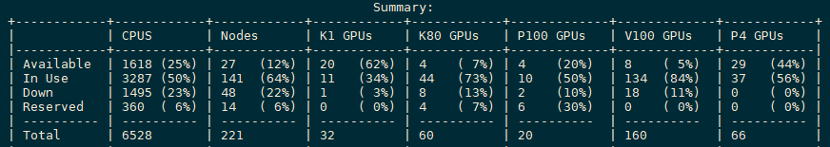
How to submit a job - check status of M3
M3 utilises SLURM scheduler to manage the resources and schedule tasks.
It is very important to figure out your computational requirements and then select the right partition.
Will the task use more CPU, or more GPU, or more memory?
Resource available Partitions Available
show_cluster to see the usage of hardware resource.

Slide 15
How to submit a job - a job script template
#!/bin/bash
#SBATCH --job-name=fly1_chan15
#SBATCH --account=ot95
#SBATCH --ntasks=1
#SBATCH --cpus-per-task=1
#SBATCH --ntasks-per-node=1
#SBATCH --time=00:30:00
#SBATCH --mem-per-cpu=4GB
#SBATCH --partition=comp
module load matlab
matlab -nodisplay -r "run('helloworld.m');exit;"
Specifications of your job
Actual execution (Python, Matlab etc.)

Slide 16
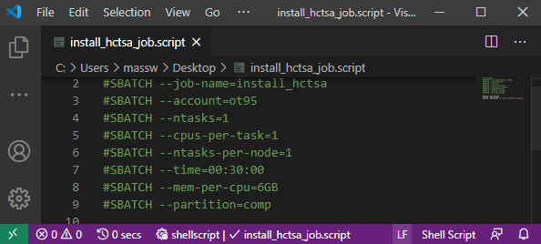
End of file - CRLF and LF
The text editor in Windows usually ends up a text file with CRLF.
But the system runs on MASSIVE is Linux !
Make sure that you chose LF in the text editor !!!!

Slide 17
How to submit a job - software on MASSIVE
module load matlab
Use the module to load the software you need.
Software on M3

Slide 18
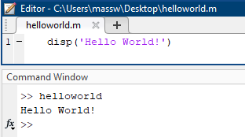
How to submit a job - code file example
It depends on what you want to do, here I show a trivial example in Matlab.

Slide 19
How to submit a job - SLURM commands
Useful SLURM commands
squeue : list all jobs waiting in the queue.
show_cluster : show all clusters in order to select a cluster with the correct configuration here.
show_job : display the status of your job.
sbatch <slurm_script_file> : submit a job
scontrol show job <JOBID> : show details of particular job (with job id)
scancel <JOBID> : cancel a job
Submit a job in the terminal window
$ sbatch <filename>.script

Slide 20
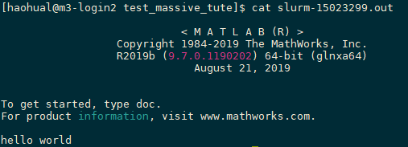
How to submit a job - returned results
I submitted the job.script which contains the job script template. The code file hello.m is in the same directory.
Open the slurm-<Job Id>.out file.
My workspace
Submit the job
Outputs

Slide 21
Write your own job script (1)
NOTE: parallel computing needs support from the program. Simply changing the parameters here will not have any impact.
#SBATCH --job-name=<job name>
Specify the name of the job, for example, IIT_sleep_data
#SBATCH --account=<project ID>
You may need ask the supervisor for the project ID. It is ot95 in my M3 account
#SBATCH --ntasks=n
The number of processes for this job. Most of time (for serial computing), keep n=1.
If you want to run parallel jobs using MPI, n is up to you. Read this.
#SBATCH --ntasks-per-node=n
The number of processes running in a single node. Most of time, keep n=1.
Some nodes have limited CPU cores. n is up to you if want to use a crazy number of CPUs.
#SBATCH --cpus-per-task=n
The CPU cores used by a process. Keep n=1 if you don’t know MP.
The number n is up to you. But using more CPU cores, lower priority of your job. Read this.

Slide 22
Write your own job script (2)
#SBATCH --time=HH:MM:SS
The maximum wallclock time for your job. (less than 7 days)
NOTE: if your job is expected to take more time, MASSIVE will schedule your job with a lower priority. But be careful, MASSIVE will also kill the job if exceeding the time specified here.
#SBATCH --mem-per-cpu=4GB
#SBATCH --mem=4GB
The memory space allocated for your job. If your job require more RAM than this, then MASSIVE will kill the job.
NOTE: more memory space, lower priority
For most of time, the two statements above are same. But if you decide to use parallel computing, then they are different. While mem refers to the total memory, mem-per-cpu refers to memory used by each CPU core.

Slide 23
Write your own job script (3)
#SBATCH --partition=comp
Nodes belong to different partitions which allow corresponding jobs to run on them.
It is fine to leave comp here. But it can be m3a, m3c, m3d, m3f and other partitions. Confuse? read available partition
Save the job script as job.script
Everything in place

Slide 24
Write your own job script (4)
How to let my job start quicker (cut in line) ?
Read QoS (Quality of Service)
#SBATCH --qos=<shortq, rtq>
Will be executed before --qos=normal
But trade-off !
Limited hardware resource
Limited walltime (the maximum time that the program can take).

Slide 25
Thank you
Thank you for your time
Please email me if I make something stupid.
hli258@student.monash.edu
Technical issue : help@massive.org.au

